Slide 1

Introduction to LangGraph

Slide 2
Agentic Systems:
Systems that utilize LLMs to manage the control flow of applications
Understanding Agentic Systems
Key Functions:
Routing decisions, tool selection, and evaluating output sufficiency
Agent Loop:
Continuous decision-making process that enables agents to solve complex tasks

Slide 3
User Input
LLM Evaluation
The Agent Loop
Action Needed
Response Sufficient
Execute Action
Send Output to User
Observe Outcome

Slide 4

Practical Use Case: Customer Support Agent
Scenario:
An LLM-powered customer support agent.
User Input:
Customer asks about order status.
LLM Decision:
Determines if it can provide the status directly or if it needs to fetch data from the database.
Action Taken:
If data fetch is needed, the agent queries the database and updates the user with the order status.

Slide 5
Flexibility:
Agents can adapt to various tasks by determining the best action to take.
Specialization:
LLM agents can be specialized with tools to perform niche tasks.
Advantages of LLM Agents
Multi-Agent Collaboration:
Specialized LLM agents can collaborate to perform complex tasks.

Slide 6
Key Components of Agentic Systems
Tool Calling: Utilizing external tools to perform tasks.
Action Taking: Executing actions based on LLM outputs.
Key Components
Planning:
Structuring steps to ensure optimal decision-making.
Memory:
Keeping track of interactions for context- aware responses

Slide 7
Agent as Graphs
Workflows build with agents are usually structured as graphs
User
Prompt
LLM
Output
Action

Slide 8
Why LangGraph?
LangGraph is designed for building agentic applications with some core principles:
Controllability:
Offers low-level control which increases reliability in agentic systems.
Human-in-the-Loop:
Built-in persistence layer enhances human-agent interaction patterns.
Streaming First:
Supports streaming of events and tokens, providing real-time feedback to users.

Slide 9
The Basic Components of LangGraph
LangGraph models agent workflows as graphs:

Slide 10
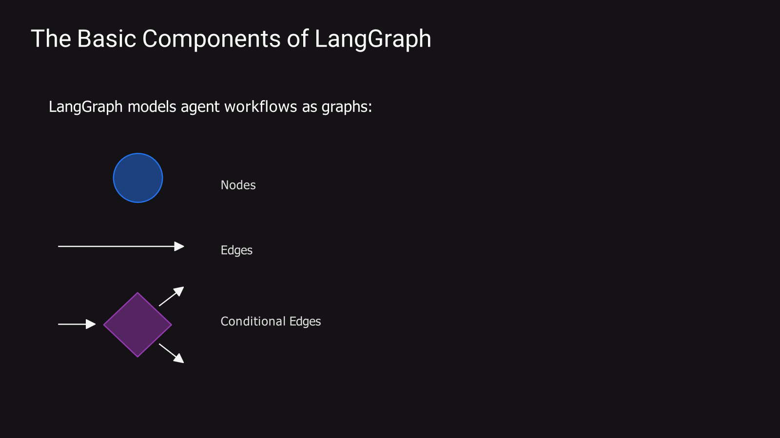

Slide 11
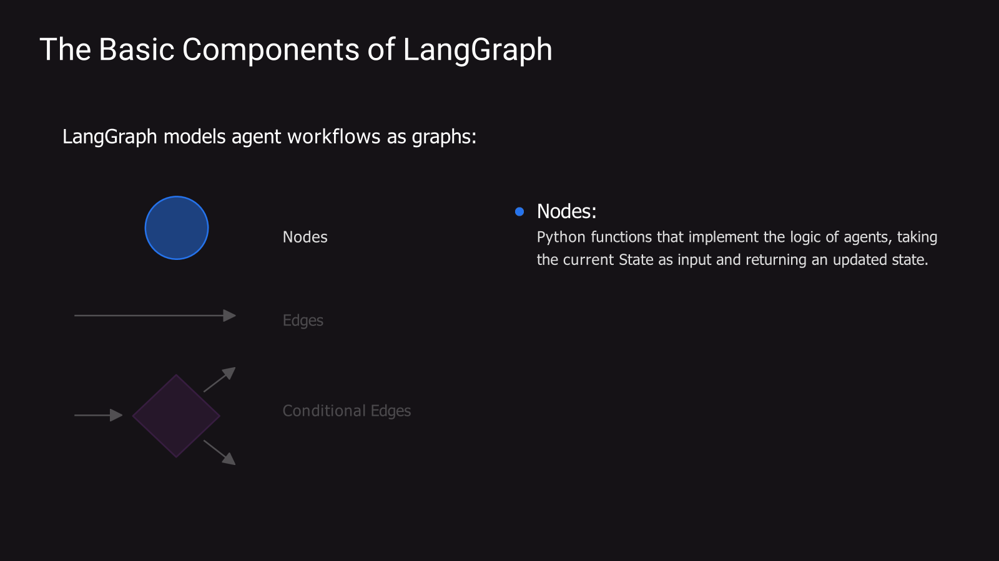

Slide 12
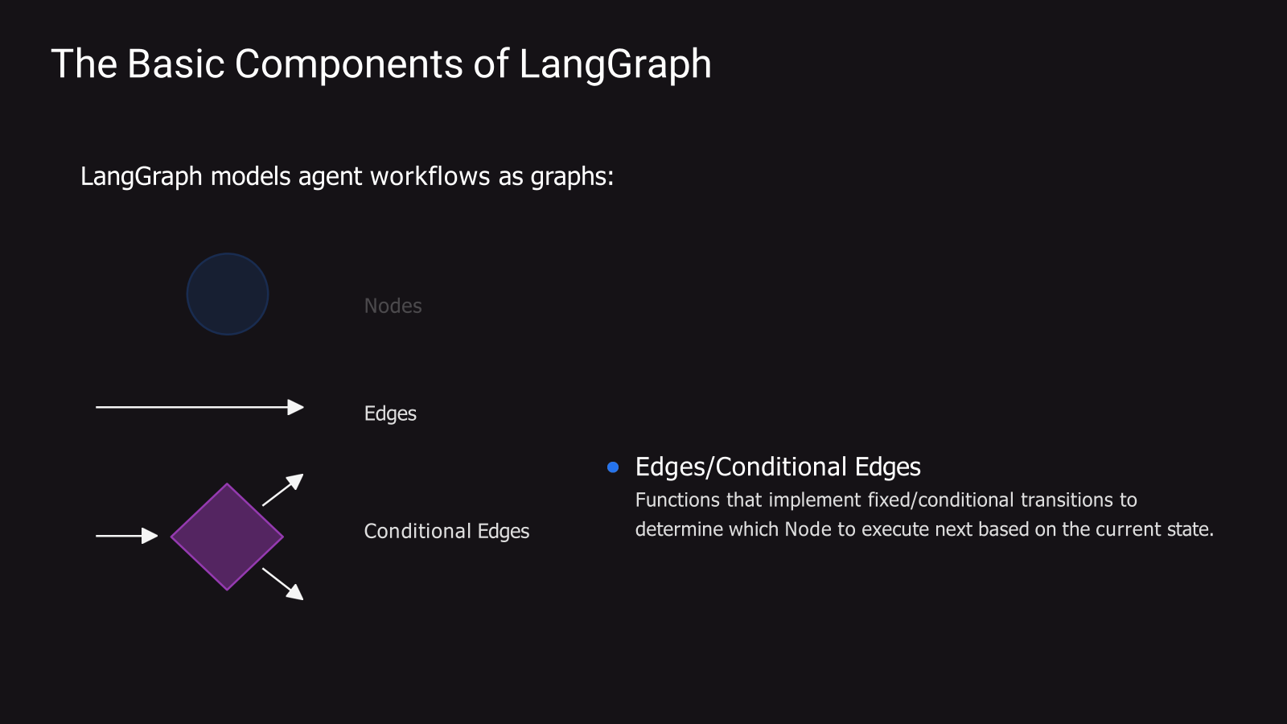

Slide 13
Graphs in LangGraph are driven by:
States:
Shared data structures that evolve over time as Nodes execute and pass messages along Edges.
States in
LangGraph
Message Passing:
Nodes send messages to activate other Nodes, facilitating the execution of workflows in discrete iterations or "super-steps".

Slide 14
In LangGraph, Nodes are the core functional units:
Functionality:
Each Node is a Python function that processes the current State and outputs an updated State.
Nodes
Execution:
Nodes can run synchronously or asynchronously and are added to the graph using the add_node method.
Special Nodes:
Includes START and END Nodes to manage the flow of execution in the graph.

Slide 15
Edges define the routing logic in LangGraph:
Types of Edges:
Normal Edges: Direct transitions from one Node to another.
Conditional Edges: Determine the next Node(s) to execute based on a function's output.
Entry Points: Specify which Node to invoke first based on user input.
Edges
Parallel Execution:
Multiple outgoing edges from a Node can trigger parallel execution of destination Nodes.

Slide 16
Thank You

